Slide 1

Energy Efficient Integration Setup
for Autonomous Agriculture
Upload this document to your team’s personal space before May 5th, 2019, 11:59pm

Slide 2

TEAM PRESENTATION
SIVANATHAN
GOWRI
20
HONOURS BUSINESS ADMINISTRATION
IVEY BUSINESS SCHOOL
GSIVANATHAN.HBA2020@IVEY.CA
416-625-4384
Problem-solver, storyteller,
& digital native.
SHAO
YUHAN
23
UNIVERSITY OF TORONTO
COMPUTER SCIENCE SPECIALIST
yuhan.shao@mail.utoronto.ca
647-809-7780
El-chami
Ibrahim
The personal data collected about the participants is obligatory for the treatment of their participation in the contest. In the absence of communication of these data, your participation could not be taken into account. They are exclusively intended for Agorize, responsible for processing. In accordance with the Data Protection Act, you have the right to access and rectify your data, as well as a right to object for legitimate reasons with Agorize, 34 rue du Faubourg Saint Antoine, 75012 Paris, by mail accompanied by a copy of any signed identity document.

Slide 3
PRE-SELECTION PACKAGE
TIPS AND TRICKS (1/2)
Dear Participants,
It’s time to present your project and your team in a 10 slides maximum. You may also include other annexes. Your presentation must include the following:
Problem statement and summarized description of your proposed solution and explain how it helps to solve one of the UN Sustainable Development Goals listed in the Discover AI: Sustainable Life Challenge.
Indications of your target (typology, characteristics, demographic, market size etc.)
A clear implementation plan of your solution’s technology & architecture (data and tools used, architecture plan, etc.)
The economic, social, or environmental benefits that your solution will bring to your indicated target audience/market (depending on the selected category)
A 1-slide presentation of your team, highlighting their each team member’s skills & background.
Any other important details that will help understand your project (addendums are not mandatory but highly recommended).
You may change the layout of these slides if you believe it will help sell your project to the selection committee.
Please delete this slide before submitting your package.

Slide 4
PRE-SELECTION PACKAGE
TIPS AND TRICKS (2/2)
As a reminder, evaluation criteria is:
Adherence to the challenge topic / 4 points
Does the project adhere to one or more of the four categories of sustainable life (good health and well-being, quality education, sustainable cities and communities, and/or climate action?)
Originality/Innovation / 4 points
Does the project offer an original, innovative approach to addressing the selected problem?
Is the project ambitious or creative within the constraints of the challenge timeline?
Technical Excellence / 4 points
Does the team make effective and appropriate use of the major features of its chosen Microsoft platform(s)/technology?
Does the team effectively communicate how Microsoft’s technology is used to solve the selected challenge?
Impact/Potential/Sustainability / 4 points
Does the project address a clear need, problem, or opportunity?
Does the project fit the needs of the problem it addresses
Feasibility / 4 points
Does the team have a credible plan for implementing their proposed solution, including a project plan, resources required, and other factors?
Does the solution have a good product/market fit?
Tips to set you up for success:
Present your project clearly and efficiently.
Add supporting elements (sketches, mock ups, etc.) that may help understand your project.
Be mindful of spelling and presentation appearance.
Delete this slide before submitting

Slide 5
Growth Through Innovation Major concerns for current agricultural forms to produce sufficient yields for current and future generations
What is the problem statement?
Agriculture Challenges in Canada and the World:
Food security: the challenge of feeding 9+ billion people
Pressure on natural resources needed for agricultural production in Canada, despite unique wealth in natural resources
High-cost production for primary agricultural products.
Differences in soil quality, agriculture related technology and productive assets,
In many countries of the developing world the average farm size is in continuous decline
Food is transported (added carbon footprint) from agricultural hubs around the world, via trucks, etc…
How will it solve the issue?
Studies examining smallholder agriculture covering over 300 projects in 57 developing countries, found that sustainable agriculture increased crop yields by 79%. In addition, controlling plant growth parameters including temperature, humidity, and plant exposure to lighting, as in MIT’s open agriculture initiative yields an increase in close to 300% in crop production with higher quality crops, in terms of shape and flavors, without genetic modification.
Our aim is to further study the increase in overall crop production while maintaining or improving produce quality and planting cycles with minimal consequences on arable land. In addition, we focus on optimizing energy efficiency for the agricultural systems to run off-grid using renewable energy resources.

Slide 6
Solutions Out There Food security, food quality, natural resources and sustainability, and affordability are still major concerns.
What makes it achievable?
Expand on research into development phase. We achieve this by installing sensors to monitor aspects of plant growth, weather patterns, energy consumption, etc. The systems constantly collect data, learn, and optimize.
If there are other similar solutions out there – what makes yours unique/different?...
We are communicating with researchers around the world, including universities and research institutes, on collaborative approaches to address several agricultural and energy related challenges and applications. Researchers around the world have been implementing different approaches to the several local and global issues related to agriculture.
While MIT focuses towards building a database on plants' optimal growth parameters as well as use machine learning to identify unknown plants, we want to integrate some aspects with other systems (AI, ML for example) to go beyond and try to make the optimization of growth processes partially or completely autonomous, with emphasis on produce quality and planting cycle without reducing the overall plants’ life cycle or exhausting plants or natural resources. Apart from the growth processes themselves, we also want to include energy consumption and communication between farming stations, in an attempt to have collaborative “community farming”.
Farm From a Box is a kit designed to make it easier for all types of organizations to start growing sustainable food. Nonprofit humanitarian agencies, schools, community groups, and even individuals can buy a $50,000 kit, which comes with a complete water system including a solar-powered pump and drip irrigation system. Together, those features help conserve water by using it more efficiently, delivering water directly to the roots of growing plants. All of the kit’s components are solar-powered, so the kit also includes 3 kW of solar energy capacity which is enough to power the water pump as well as WiFi connectivity that makes it possible to monitor the farm conditions remotely. Because the built-in solar power technology generates more than enough energy to power the farm’s equipment, the farm is suitable to run completely off the grid.
Affordability is a major concern because it hinders wide scale implementation or even deployability in developing countries

Slide 7
Solutions Out There Food security, food quality, natural resources and sustainability, and affordability are still major concerns.

Slide 8
Collaborative Community Farming
Who is your target audience? Why? What are the characteristics of that audience? What is the size of the target market you will be tapping into?...
Start small to control as much as possible of the environment, then move onto small scale and Smallholder agriculture.
we also want to include energy consumption and communication between farming stations, in an attempt to have collaborative “community farming”.

Slide 9
SOLUTION’S ARCHITECTURE
Some questions you may want to answer: How will you build your solution? What data will you be using? How will you obtain that data? What will be you solution’s architecture? What tools & technology will you use? ..
Local dataset (generated by the system itself as well as agriculture datasets from UBC, KUL, VUB, and imec) to be used as training data. In addition, there are publicly available agricultural databases for natural and optimal growth factors. There’s also the potential to use databases from University of Saskatchewan’s image database (Crop phenotype project).
TECHNICAL COMPONENTS
Hardware: Azure IoT dev boards, raspberry pi, arduino-compatible boards, some sensors:
monitor and collect sensors’ data raspberry pi, arduino boards,
Azure IoT Edge, IoT Central, remote sensing as well as some of Azure’s storage, cloud platform, and visualization (Office APIs) apps. Azure ML, Custom Vison AI on Azure IoT Edge.
Collect data from sensors and images from cameras at multiple sources (4 cabinets), while the cabinets also communicate with each other. 2 cabinets in short range of each other communicating data such as shared resources. 2 other distant cabinets, from each other and from the 2-short range cabinets, with specific added variable, such as mild wind effects. Sensors in different cabinets communicate data of different (and added) parameters within the same farm land.
Using these services, the project will advance the following technical solutions
• Remote feedback and visualization
• Classification of images of several phases of plant growth and weather forecasting
• ML/AI of energy (generation, storage, and consumption data)

Slide 10
Current progress
Who will benefit from your solution? What are the direct potential benefits? Are they quantifiable? How does your solution contribute towards sustainable development?

Slide 11
UV lamps
(angled, with
reflections)
microcontroller (arduino based)
Connected to local server (r-pi)
Water pump/pipe
Air fan
Temp/
Humidity
plant
Camera
pH sensor

Slide 12
Monitoring Station
Temp/
Humidity
microcontroller (arduino based)
Connected to local server (r-pi)
Air pump
Water pump
[CO₂]
Manually controlled pH
Different plants:
Basil, parsley, etc..
Water pump
Overhead UV LED panel

Slide 13
Manual
Control
For relays
Monitoring
panel
Export data
(csv)
Images

Slide 14
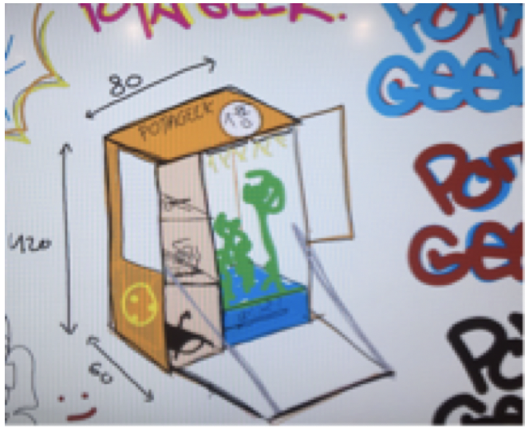
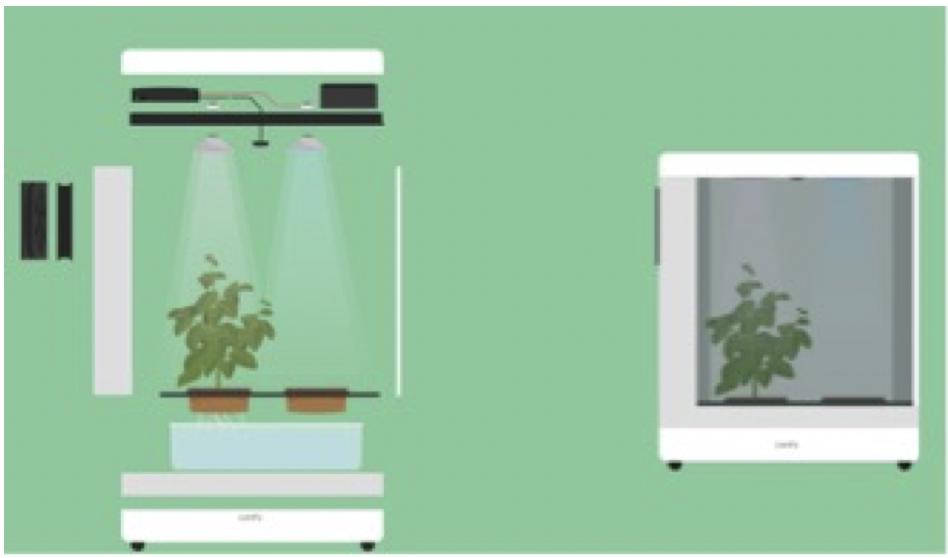
Box design for the 2 boxes
Design for the next two boxes focusing on further energy optimization (using surrounding/sun UV light, and curtains), portability, and communication with other boxes

Slide 15


Overview
Prediction (Machine Learning)
Communication between parts of the electric grid
system, energy system, and other houses/ generation systems
Generation
In-house
Monitoring System
Consumption
Storage
In progress
Future work
In progress: communication
with other solar panels
Future: communication
with other systems (wind)
Notes:
https://www.smart-energy.com/wp-content/uploads/2016/04/Solar-Villiage-e1461052987384.jpg
https://www.lboro.ac.uk/microsites/enterprise/smart-energy-cities/
https://finkube.com/wp-content/uploads/2016/09/AI-Icon-300x278.png
https://snp.azureedge.net/cdn/farfuture/izAb_a9wXdN07GTHs-G8xHpGuTIzHEO8ZuDAyz4ENCI/1502879770/sites/default/files/2017-08/BLOG%20PIC%201_0_0.jpg
https://powerbicdn.azureedge.net/mediahandler/blog/legacymedia/0160.clip_5F00_image001_5F00_44F32E94.png
https://bam.files.bbci.co.uk/bam/live/content/zfxv9j6/large

Slide 16
Load example
Microcontroller to process data from sensors
Wifi communication
Current sensor
Real time
Parameters monitoring
Power Consumption, weather, etc

Slide 17
Weather data
Forecast
Consumption system (LED strip)
receives requests based on energy prediction output (weather forecast within the next 5 days, in 3 hrs intervals)

